Slide 1
KOHONEN SELF ORGANIZING MAPS
The main property of a neural network is an ability to learn from its environment, and to improve its performance through learning.
So far we have considered supervised or active learning − learning with an external “teacher” or a supervisor who presents a training set to the network. But another type of learning also exists: unsupervised learning.

Slide 2
SOM
In contrast to supervised learning, unsupervised or self-organised learning does not require an external teacher. During the training session, the neural network receives a number of different input patterns, discovers significant features in these patterns and learns how to classify input data into appropriate categories. Unsupervised learning tends to follow the neuro-biological organisation of the brain.
Unsupervised learning algorithms aim to learn rapidly and can be used in real-time.

Slide 3
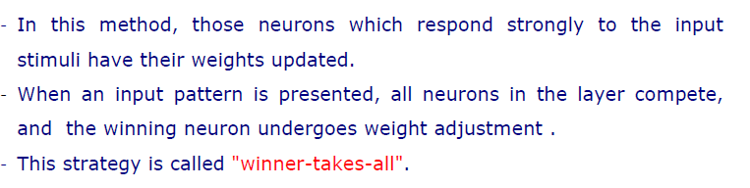
Compititive Learning

Slide 4
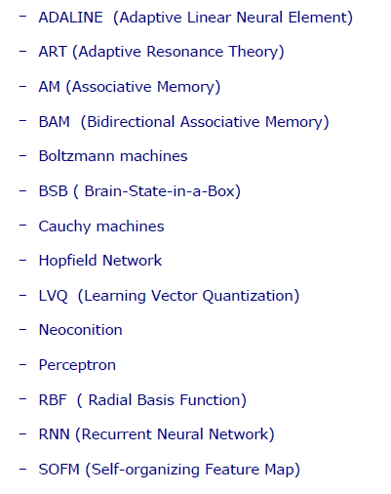
Neural Network Models

Slide 5
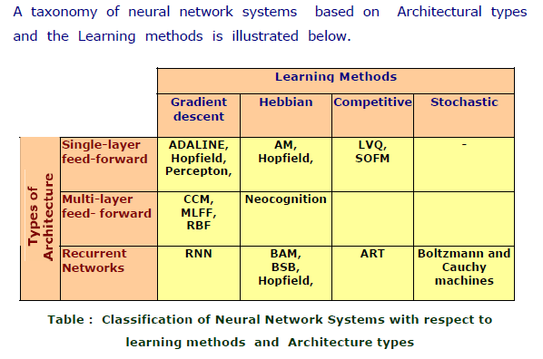
Classification of Neural Networks

Slide 6
SOM
The Kohonen model provides a topological mapping. It places a fixed number of input patterns from the input layer into a higher-dimensional output or Kohonen layer.
Training in the Kohonen network begins with the winner’s neighbourhood of a fairly large size. Then, as training proceeds, the neighbourhood size gradually decreases.

Slide 7
KOHONEN SELF ORGANIZING MAPS
Architecture
neuron i
Kohonen layer
w_{i}
Winning neuron
Input vector X
X=[x₁,x₂,…x_{n}] ∈ R^{n}
w_{i}=[w_{i1},w_{i2},…,w_{in}] ∈ R^{n}

Slide 8
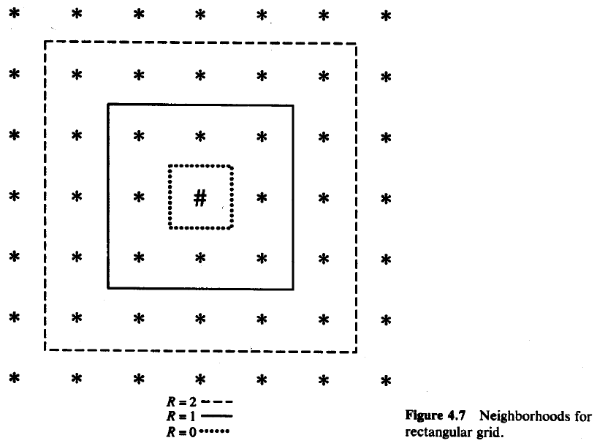
Kohonen SOM (Self Organizing Maps)
Structure of Neighborhoods

Slide 9
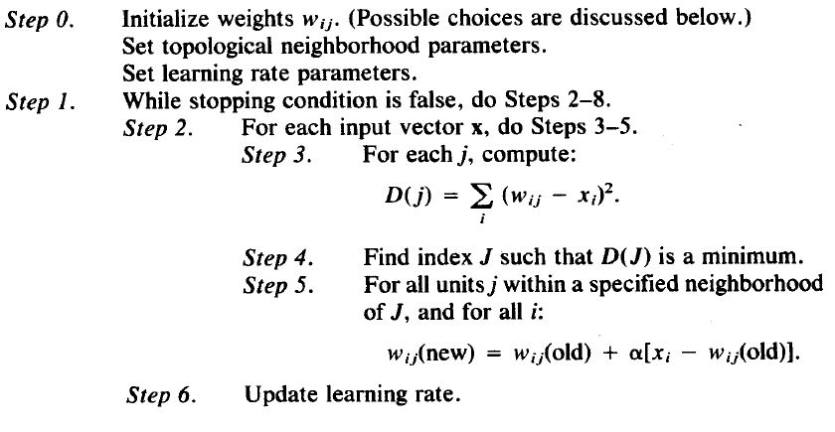
Kohonen SOM (Self Organizing Maps)
Neighborhoods do not wrap around from one side of the grid to other side which means missing units are simply ignored.
Algorithm:

Slide 10
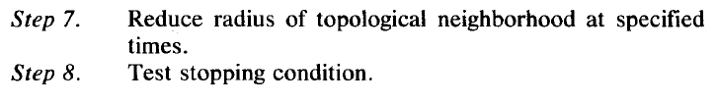
Kohonen SOM (Self Organizing Maps)- Version 01
Algorithm:
Radius and learning rates may be decreased after each epoch.
Learning rate decrease may be either linear or geometric.

Slide 11
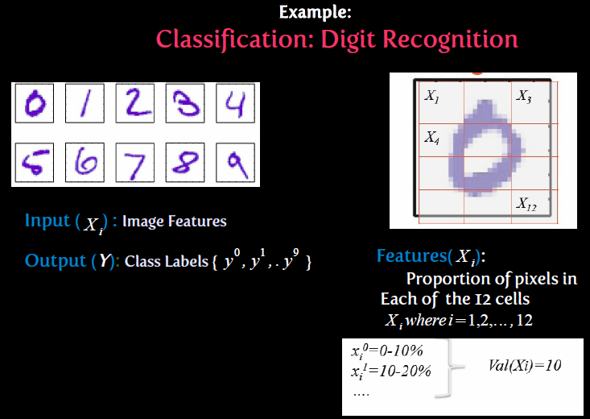
Classification : Digit Recognition System

Slide 12
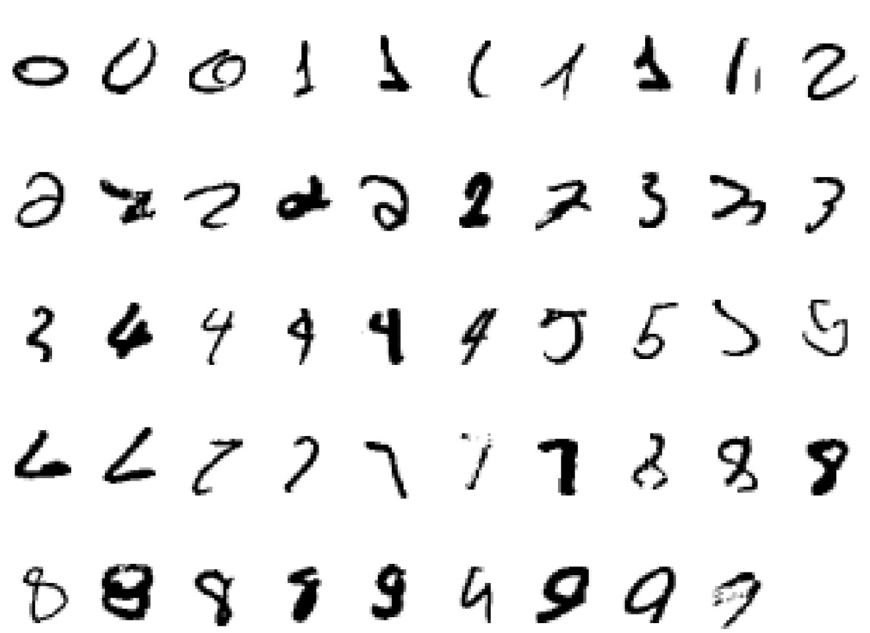
A classic example of a task that requires machine learning: It is very hard to say what makes a 2

Slide 13
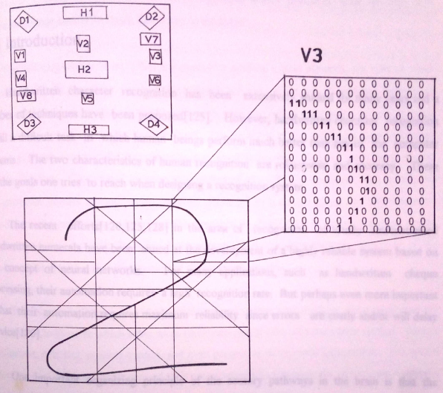
Pre-processor

Slide 14
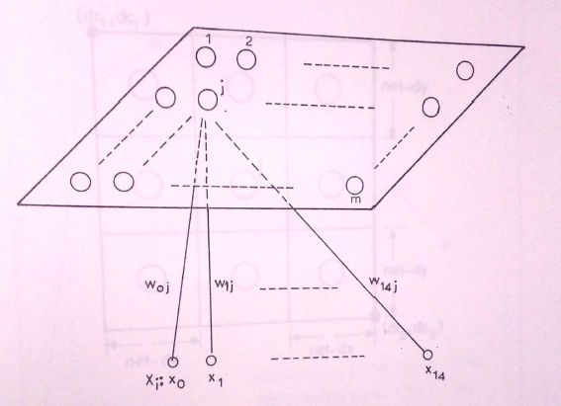
Basic Structure

Slide 15
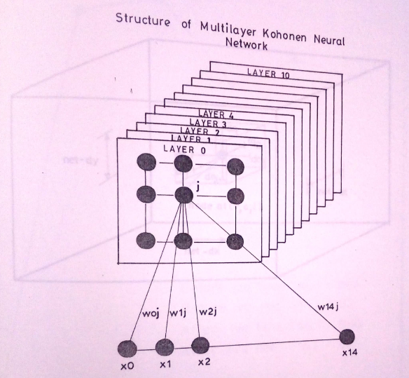

Slide 16
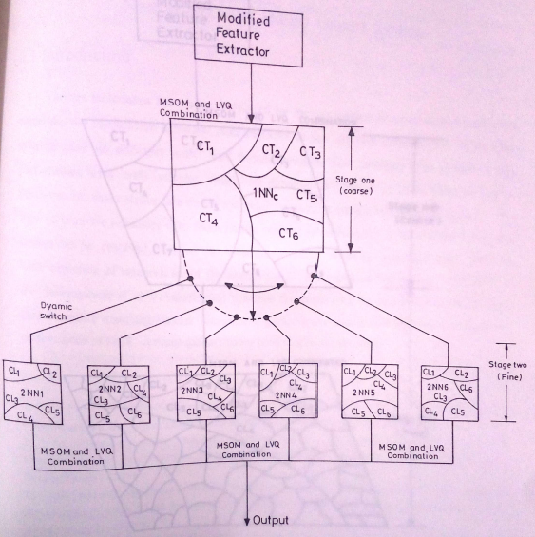

Slide 17
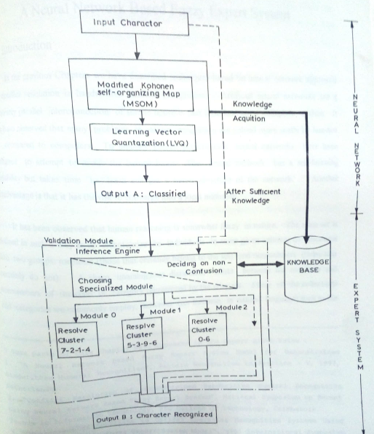

Slide 18
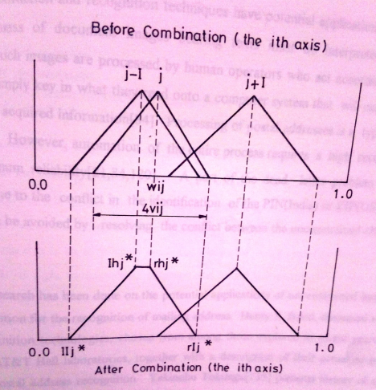

Slide 19
Case Study 04

Slide 20
Initial random weights

Slide 21
Network after 100 iterations

Slide 22
Network after 1000 iterations

